Slide 1
EER to Relational Mapping
DB:EER Model - 1

Slide 2
Objectives
Introduction +
Non-shared class Mapping +
Shared Class Mapping+
Categories Mapping +
Summary +
DB:EER Model - 1

Slide 3
- Introduction
In previous lecture we have looked at the mapping of ER diagram to relational schemas.
In this lecture we will look at the mapping of the additional construct of EER diagrams to relational schemas.
We start by discussing the mapping of the superclass/subclass relationship. After that we will look at the shared subclasses mapping. Finally we will look at the categories mapping.
DB:EER Model - 1

Slide 4
- Non-Shared Classes Mapping
Now we will look at the mapping of specialization with m subclasses {S1, S2, … , Sm} and (generalized) superclass C, where the attributes of C are {k, a1, a2, …, an} and k is the primary key, into relational schemas.
There are four options (A, B, C, or D) as will be described later.
  Options A and B: also called the multiple relations options, produce multiple relations to map the superclass/subclass relationship.
  Options C and D: also called the single relation options, produce only a single relation to map the superclass/subclass relationship.
DB:EER Model - 1

Slide 5
-- Option A
Create a relation L for C with attributes Attrs(L) = {k, a1, a2, …, an} and PK(L) = k.
Create a relation Li for each subclass Si, 1 <= I <= m, with the attributes Attrs(Li) = {k} U {attributes of Si} and PK(Li) = k.
Each Li includes the specific (or local) attributes of Si, plus the primary key of the superclass C, which is propagated to Li and becomes its primary key.
An EQUIJOIN operation on the primary key between any Li and L produces all the specific and inherited attributes of the entities in Si.
The following figure shows how option A is used to map the EMPLOYEE superclass/subclass relationship.
DB:EER Model - 1

Slide 6
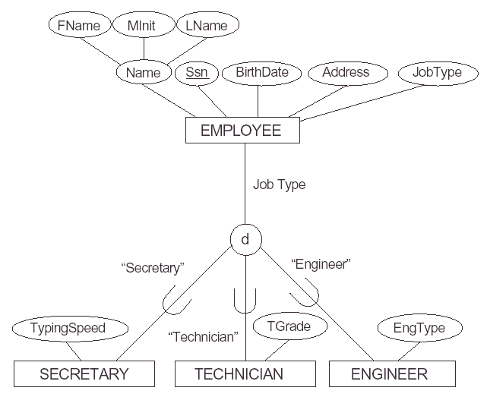
EER
REL.
EMPLOYEE
SSN
Fname
Minit
Lname
Bdate
Address
Jobtype
SECRETARY
TECHNICIAN
ENGINEER
SSN
TypingSpeed
SSN
TGrade
SSN
EngType
DB:EER Model - 1

Slide 7
Discuss in the context of:
- Partial/full participation
- Disjoint/overlapping
1- Employee (FN, MI, LN, SSN, BD, ADD,JT,TS,TG,ET)
2- Employee (FN, MI, LN, SSN, BD, ADD, SFLAG, TS, TFLAG, TG, EFLAG, ET)
3- Secretary(FN, MI, LN, SSN, BD, ADD,JT,TS)
Technician(FN, MI, LN, SSN, BD, ADD,JT,TG)
Engineer(FN, MI, LN, SSN, BD, ADD,JT,ET)
4- Employee (FN, MI, LN, SSN, BD, ADD,JT)
Secretary(SSN, TS)
Technician(SSN, TG)
Engineer(SSN, ET)
DB:EER Model - 1

Slide 8
-- Option B
Create a relation Li for each subclass Si; 1 <= I <= m, with Attrs(Li) = {attributes of Si} U {k, a1, a2, …, an} and PK(Li) = k.
DB:EER Model - 1

Slide 9
--- Example: Option B
VehicleId
VEHICLE
PlateNo
Price
NoOfPassangers
d
NoOfAxles
Tonnage
MaxSpeed
CAR
TRUCK
EER
REL.
CAR
VehicleId
PlateNo
Price
NoOfPassangers
MaxSpeed
TRUCK
VehicleId
PlateNo
Price
NoOfAxles
Tonnage
DB:EER Model - 1

Slide 10
-- Option C (Disjoint Subclasses)
Create a single relation L with attributes Attrs(L) = {k, a1, a2, …, an} U {attributes of S1} U . . . {attributes of Sm} U {t} and PK(L) = k.
This option is for specialization whose subclasses are disjoint, and t is a type (or discriminating) attribute that indicates the subclass to which each tuple belongs, if any.
This option has the potential for generating a large number of null values
DB:EER Model - 1

Slide 11
EER
REL.
EMPLOYEE
SSN
Fname
Minit
Lname
Bdate
Address
Jobtype
TGrade
EngType
TypingSpeed
DB:EER Model - 1

Slide 12
-- Option D (Overlapping Subclasses)
Create a single relation schema L with attributes Attrs(L) = {k, a1, a2, …, an} U {attributes of S1} U . . . U {attributes of Sm} U {t1, t2, . . ., tm} and PK(L) = k.
This option is for specialization whose subclasses are overlapping (but will also work for a disjoint specialization), and each ti, 1 <= I <= m, is a boolean attribute indicating whether a tuple belongs to subclass Si.
DB:EER Model - 1

Slide 13
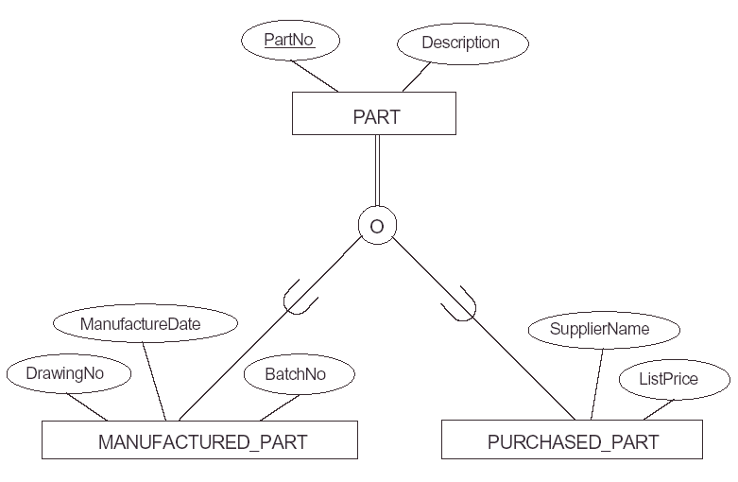
--- Example: Option D
EER
REL.
PART
PartNo
Description
MFlag
DrawingNo
ManufactureDate
BatchNo
PFlag
SupplierName
ListPrice
DB:EER Model - 1

Slide 14
- Shared Class Mapping
As it was stated during the discussion of EER concepts, a shared subclass is a subclass of several superclasses, such as ENGINEERING_MANAGER. These classes must all have the same key attribute; otherwise, the shared subclass would be modeled as a category, which will be discussed later.
We can apply any of the options discussed in the previous step to a shared subclass, although usually option A is used.
DB:EER Model - 1

Slide 15
- Category Mapping …
A category is a subclass of the union of two or more superclasses that can have different keys because they can be of different entity types.
An example is the OWNER category shown in the following figure, which is a subset of the union of three entity types PERSON, BANK, and COMPANY. The other category in that figure, REGISTERED_VEHICLE, has two superclasses that have the same key attribute.
For mapping a category whose defining superclass have different keys, it is customary to specify a new key attribute, called a surrogate key, when a relation to correspond to the category. This is because the keys of the defining classes are different, so we cannot use any one of them exclusively to identify all entities in the category.
DB:EER Model - 1

Slide 16
… - Category Mapping
We can now create a relation schema OWNER to correspond to the OWNER category, as illustrated in, and include any attributes of the category in this relation.
The primary key of OWNER is the surrogate key OwnerId. We also add the surrogate key attribute OwnerId as a foreign key to each relation corresponding to a superclass of the category, to specify the correspondence in valued between the surrogate key and the key of each superclass.
For a category whose superclasses have the same key, such as VEHICLE in the figure, there is no need for a surrogate key. The mapping of the REGISTERED_VEHICLE category, which illustrates this case, is also shown in the mapping figure.
DB:EER Model - 1

Slide 17
--- Example: Category Mapping
SSN
PERSON
Name
BANK
Address
COMPANY
Name
Name
License
Address
Address
U
U
OWNER
EER
REL.
PERSON
SSN
License
Name
Address
OwnerId
BANK
BName
BAddress
OwnerId
COMPANY
CName
CAddress
OwnerId
OWNER
OwnerId
DB:EER Model - 1

Slide 18
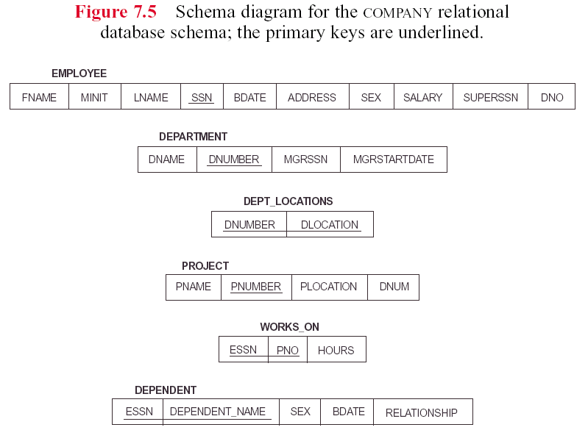
DB:EER Model - 1

Slide 19
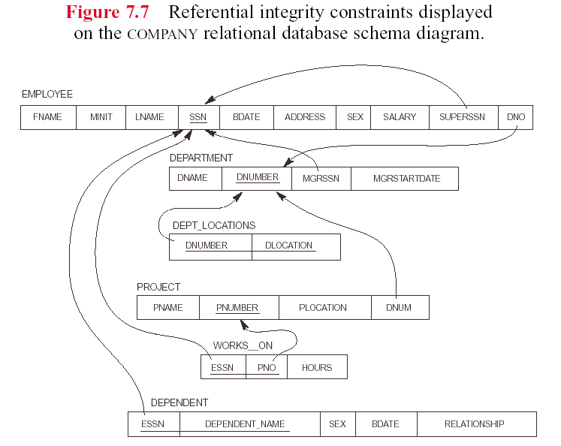
DB:EER Model - 1

Slide 20
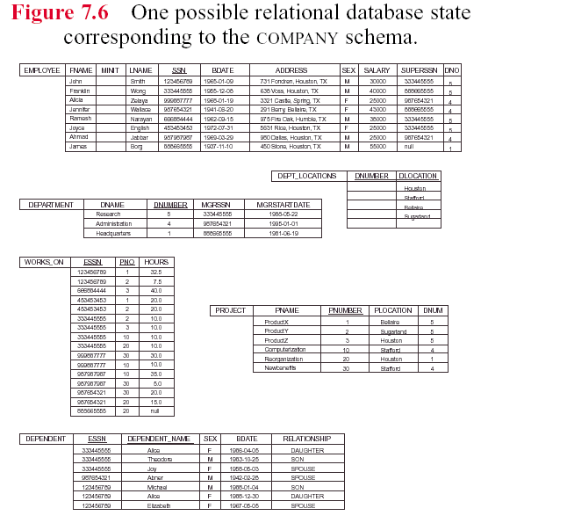
DB:EER Model - 1

